Slide 1

NEW HAMPSHIRE HOUSING MARKET OVERVIEW
Rob Dapice and Jack Ruderman
January 4, 2024
Notes:
Thanks for having me
I’m pleased to be a part of this event.
I’m Heather McCann and I’m the Senior Director of Research, Engagement & Policy and New Hampshire Housing.

Slide 2

WE PROMOTE, FINANCE, AND SUPPORT
HOUSING SOLUTIONS FOR THE PEOPLE OF NH
Established in 1981 by state legislature as a self-sustaining public corporation
Not a state agency – no state operating funds
Governed by a 9-member Board of Directors that is appointed by Governor and Council
Notes:
I’m going to share some information on the housing market within the state but before I get into that, I like to explain what New Hampshire Housing is and why it exists.
We were Established by NH State Law in 1981 as a self-supporting public corporation.
We manage a wide range of programs that advance our mission: which is to PROMOTE, FINANCE, and SUPPORT HOUSING SOLUTIONS FOR THE PEOPLE OF NH.
Some of those programs are funded with Federal or State dollars. However, we don’t receive any operating funds from the state and we are not state employees.
Because we serve the public and in some cases we administer public funds, our structure is designed to incorporate accountability. That’s done through our board of directors, which we have 9 members, and they are appointed by the Governor.
Our office is located in Bedford. You can learn more at our website, www.nhhousing.org.
Now I am going to touch on some of our divisions and programs that we run in order to advance this mission.

Slide 3
OUR IMPACT
NEW HAMPSHIRE HOUSING HAS…
  Helped more than 55,000 families purchase their own homes
  Provided financing to create 16,000+ multifamily units
  Provided direct assistance to tens of thousands of households
  LAST YEAR NEW HAMPSHIRE HOUSING…
  Financed 1,800 units of multifamily rental housing
  Monitored operations of thousands of units of rental housing we financed
  Administered federally funded rental assistance for
  9,000 households statewide
  Helped 1,300+ families purchase a home
Notes:
Our homeownership division doesn’t do direct lending but rather works with a wide network of lending institutions across the state who offer our products to serve first-time and moderate-income homebuyers which includes downpayment assistance.
Our Multifamily Division provides below market financing to developers in exchange for their commitment to rent their apartments to low or moderate income people for rents they can afford. We use a variety of tools for this, including the federal Low Income Housing Tax Credit and HOME and Housing Trust Fund, plus the state Affordable Housing Fund. We have also been able to utilize funds from the InvestNH program which has also supported the creation of affordable housing units.
These affordable apartments are monitored by our staff to ensure they are well managed and maintained, and they are required to remain affordable for decades into the future.
Our assisted housing division administers over 4,200 HUD-funded Housing Choice vouchers also known as Section 8 vouchers, which provides direct assistance to low-income households throughout the state.
I also want to highlight that we do not do anything alone and we work with so many partners to advance our mission from government agencies like BEA and nonprofits like PlanNH and so many more.

Slide 4

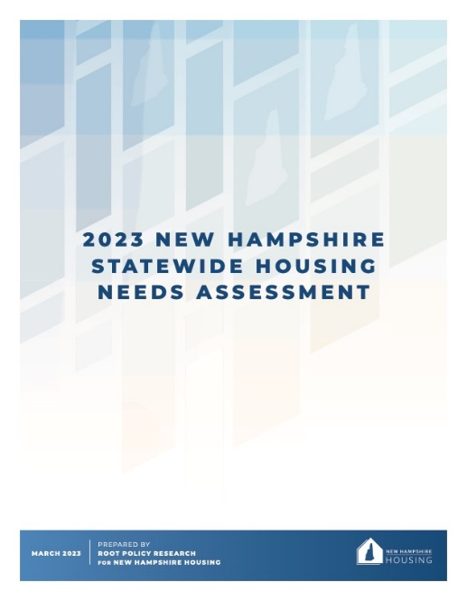

RESEARCH • ADVOCACY • POLICY
  Housing Studies and Reports
  Annual Residential Rental Cost Survey
  Housing Advocacy/Technical Assistance and grants
  Housing Planning Reports (state & federal)
  Conferences focused on housing issues and policies
  InvestNH Municipal Planning & Zoning Grants
Notes:
Our Research, Engagement & Policy team, which I am part of provides data, reports and planning tools. We work with community partners around the state on housing advocacy issues to support ways to raise awareness about the need for a balanced supply of diverse and affordable housing, and way this can be achieved.
This is the team that also works together with PlanNH to administer the InvestNH Municipal Planning & Zoning Grants which Tiffany will talk more about.
What you will see in these next few slides is some of the data and research done by this team which allows us to know what’s going on within our housing market.

Slide 5
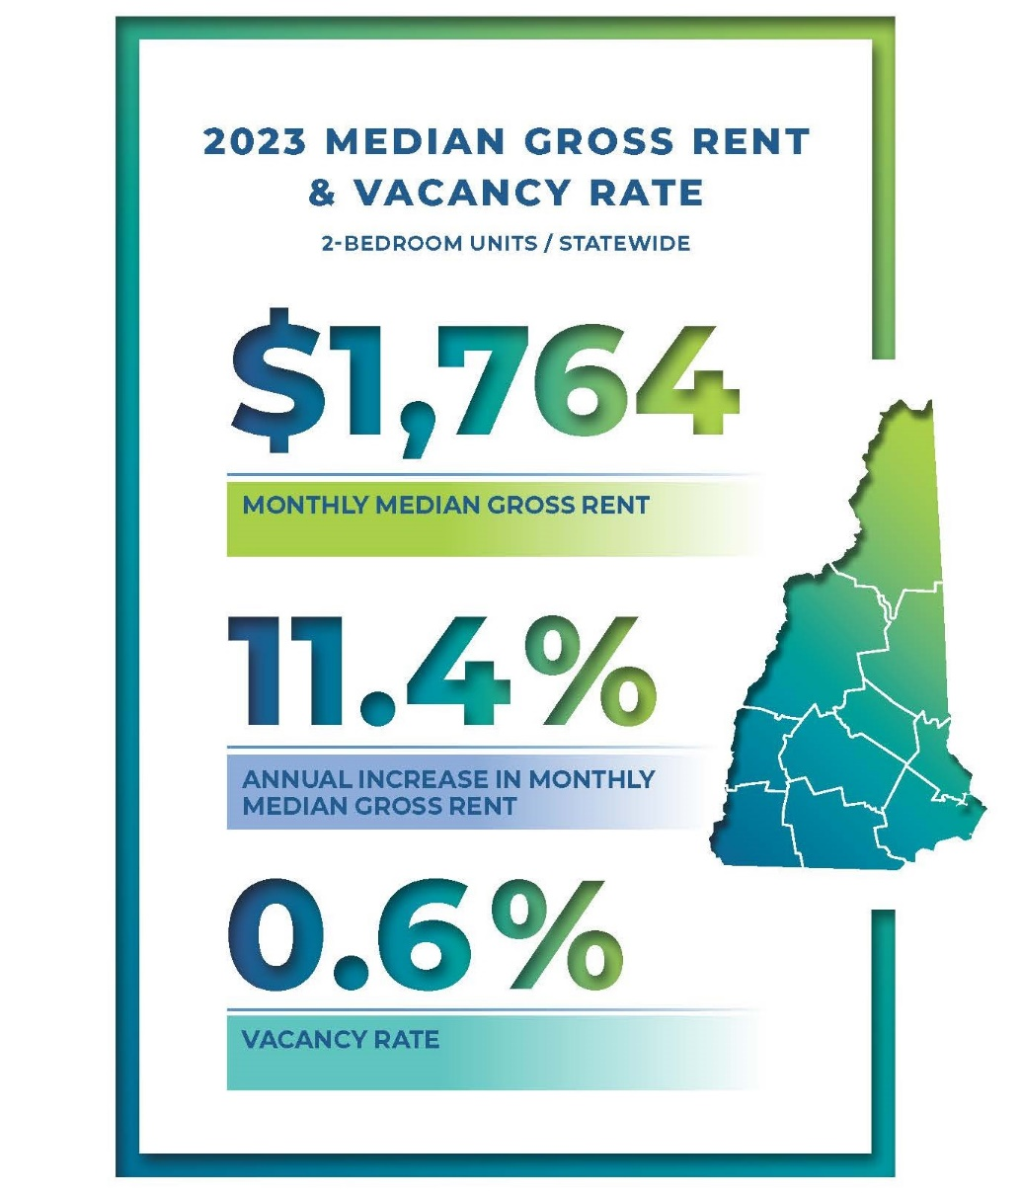
2023 RESIDENTIAL RENTAL COST SURVEY
Notes:
Every year we conduct a residential rental cost survey, where we survey market-rate apartments across the state. Our most recent survey revealed that the median gross rent (which is rent plus utilities) across the state is $1,764. This is an 11% increase from 2022. It also revealed a vacancy rate of less than 1 percent.

Slide 6
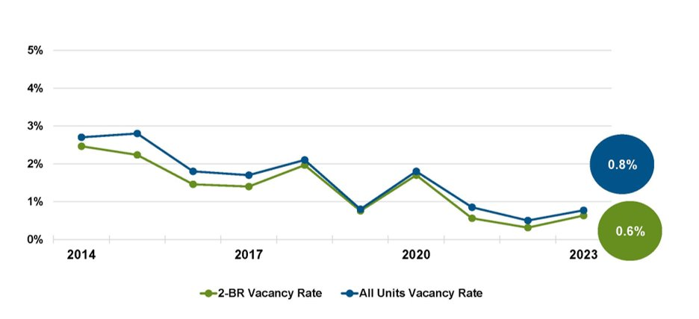
VACANCY RATE OF RESIDENTIAL RENTAL UNITS​
Notes:
Vacancy rate is important because it allows us to see what’s available for people to rent. To put this into perspective, 5% is considered a balanced market and 3% is considered turnover. We’ve been below 3% for quite some time.

Slide 7
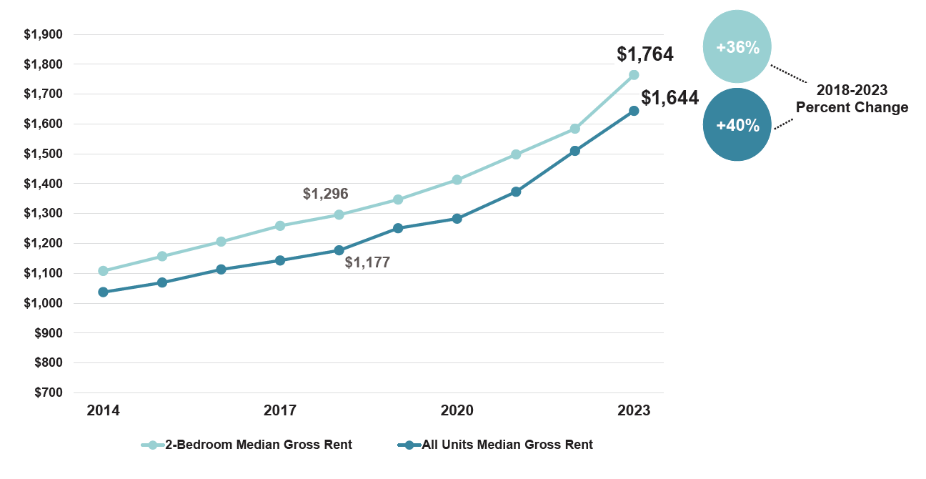
MEDIAN GROSS RENTAL COST
Notes:
And the impacted of having a limited supply is demand goes up as does cost. You can see rental cost have continues to rise but around 2020, when the pandemic hit, you see the costs rising more sharply We’ve seen a 36% increase for 2br units in the past 5 years and a 40% increase for all units combined.

Slide 8
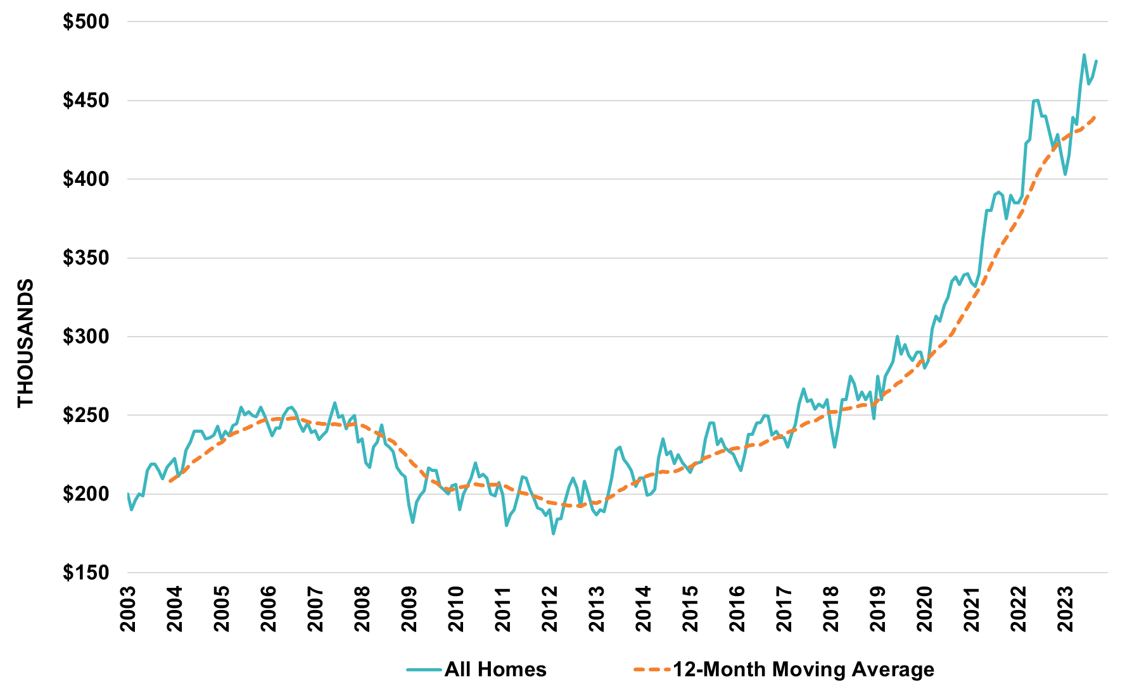
SINGLE-FAMILY MEDIAN SALES PRICE STATEWIDE
Source: PrimeMLS
Notes:
Now on the purchase side, in NH the median sales price in September was $475,000. New Hampshire Housing does our own analysis where we remove seasonal properties, timeshares, cash-only/dilapidated properties to get an idea of what the market looks like from the lens of a first-time homebuyer.
This is up 22% from two years ago, and up 11% from last year ($430K). So, prices seem to be slightly tempering, although still very high.

Slide 9
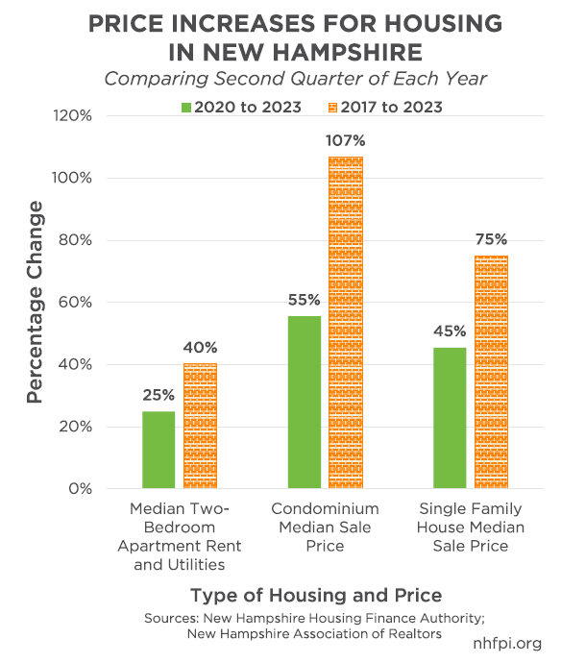

Slide 10
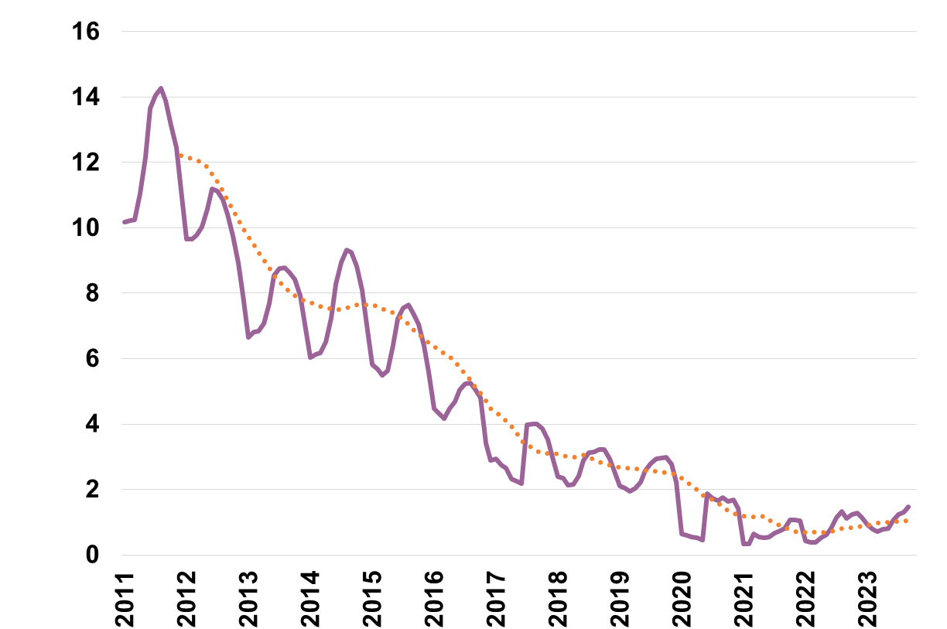
MONTHS OF SUPPLY OF INVENTORY
Less than
6 months of inventory is considered a seller’s market.
Notes:
Why are prices so high? Well, the purchase market is in the same situation as the rental market, there is not enough inventory which creates demand and so prices increase. Currently we are at about 1.5 months of inventory, which means if we didn’t add any new listings to the market, at the prior 12 months sales pace, it would take a month and a half to sell off all the properties.
6 months is considered a more balanced market. A balanced market is considered the ideal situation for both buyers and sellers because it provides stability and predictability. We’ve been under 6 months for quite some time.
​
And this has the greatest impact on those who are attempting to enter homeownership.
1.5 months of inventory

Slide 11
NH BUILDING PERMITS ISSUED 1980 - 2022​
Notes:
A big piece to this, is we are not building enough housing.
So that curve in the middle, that’s pre-great recession. But look back to the 1980’s, my goodness, how much building there was going on in New Hampshire and if you extended this back into the 1970’s you’d see another building boom. ​
So we had a recession in early 1980’s, we had a recession in the late 80’s early 90’s, we have the great recession in 2008 and 2009, If you look at the curve moving into present day, we are building at recessionary levels, during the period of the greatest economic expansion in our nation’s history, New Hampshire is building at recessionary levels. And this has an impact on our state’s economy.

Slide 12
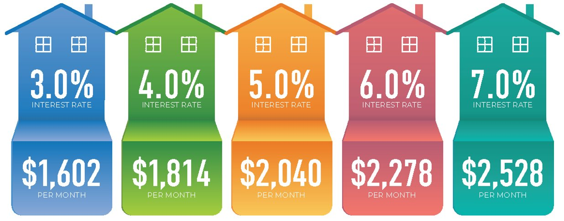
IMPACT OF INTEREST RATES
Interest rate and payments calculated based on $400,000 home with 5% down payment, 30-year mortgage. Per-month cost reflects principal and interest only, excludes estimated insurance and taxes.
Notes:
The impact of interest rates on affordability is incredible – this visual does a great job illustrating exactly that. We calculated the monthly cost of a $400,000 house with a 5% down payment, 30-year mortgage. With an interest rate of 3%, you would be paying about $1,602 per month, but with an interest rate of 7%, you would be paying $2,528. That’s an increase of $900 per month, so you can really see how interest rates drastically effect how much house a buyer can afford!

Slide 13
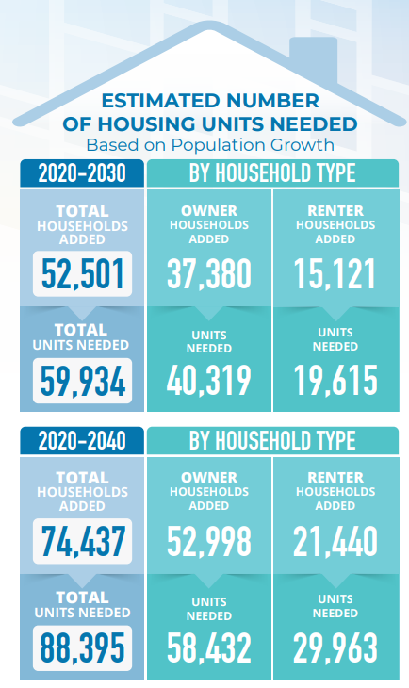
HOW MUCH HOUSING DOES NH NEED?
BASED ON ESTIMATED POPULATION GROWTH:
Almost 60,000 Units Between 2020 and 2030
Nearly 90,000 Units Between 2020 And 2040
A total of 23,670 housing units is needed today:
This is New Hampshire’s current housing shortage.
Additional funding & financing tools to support development of single-family & multifamily housing
are key. More state and federal funding sources have been allocated in recent years, but more is needed.
Through planning and zoning changes in our communities, we will be able to add different types of housing to meet the needs of NH’s people, regardless of
their income or age or where they live in the state.
Notes:
So, how much do we need to build?
We conducted a statewide housing needs assessment which says we currently need almost 24,000 units to make up for the current deficit of units and attain a healthy vacancy rate.​
Based on population projections we’ll need 60,000 units by 2030 and nearly 90,000 additional housing units by 2040.
All this may look bleak but I will say we have seen some unique opportunities and funding to help support housing development.
​

Slide 14
IS NEW HAMPSHIRE EXPERIENCING A HOUSING CRISIS?
Governor Sununu
“Earlier this summer I assembled a housing task force to develop recommendations to address our shortage, which has risen to crisis levels.” Governor Chris Sununu, October 2019
The task force’s mission is to develop recommendations to address what has become New Hampshire’s housing crisis. Council on Housing Stability, October 30, 2019.

Slide 15
NH Legislature
The Speaker of the New Hampshire House created a Special Committee on Housing in January 2023. “New Special Committee on Housing Tasked with Finding Solutions to NH’s Housing crisis.” WMUR
‘A deep need’: New Hampshire lawmakers propose slew of 2024 bills to address housing shortages. NH Public Radio, December 26, 2023
“This is by far the most housing-related pieces of legislation that we’ve seen filed in a single session before,” said Nick Taylor, executive director of the Workforce Housing Coalition of the Greater Seacoast. “And I think that in and of itself speaks to the deep need that legislators are hearing from their constituents, whether it’s the businesses that need more workers, seniors who are looking to stay in their homes, younger families looking to buy their first home, or renters who are struggling with increased prices.”

Slide 16
The Business Community
“BIA aggressively advocates for state policies and financial incentives to spur the development of more affordable workforce housing, because housing is at the center of our worker shortage.” Michael Skelton, President/CEO,NH Business and Industry Association.
New Hampshire has the fourth most severe level of housing underproduction in the nation. NH Business Review, October 18, 2023
“The State We’re In – Solving the Housing Crisis” BusinessNH Magazine, May 25, 2022

Slide 17
NH Realtors
Prices have been steadily climbing ever since 2012, and though housing market fundamentals are not comparable to those which prompted the recession, the steady increase in median price — rising to $395,000 in 2021 and heading for well over $400,000 in 2022 — has created an affordability and availability crisis, particularly among the first-time homebuyers so essential to a strong workforce and a healthy New Hampshire economy. NH Association of Realtors.
“We continue to see a lack of affordable housing in the state, and the affordability problem is directly tied to the inventory problem,” Ben Cushing, NHAR president, told NHJournal.
In August 2023 the New Hampshire Association of Realtors (NHAR) reported the housing affordability index fell to 59, the lowest number on record.

Slide 18
NH Bar News:
“This lack of available housing affects not only those who are struggling to find a place to land, but the rest of us, as well. If there is no affordable, available housing, employers will struggle to recruit and retain employees – out of state individuals seeking employment in New Hampshire may be forced to find work elsewhere, and existing NH residents, (particularly younger individuals) may choose to leave the state. “New Hampshire’s Housing Crisis…,” NH Bar News, December 20, 2023.

Slide 19
NH Fiscal Policy Institute
“New Hampshire’s lack of affordable Housing is a substantial labor force and economic constraint.”
“The housing crisis is harming New Hampshire’s economy and its communities.”
“New Hampshire’s shortage of available housing units has contributed to rapid rental and house price increases in the State since the beginning of the pandemic.”

Slide 20
Josiah Bartlett Center
“A combination of high interest rates and an extreme shortage of homes on the market has pushed housing affordability to a two-decade low in the state.”
Americans for Prosperity
“Americans for Prosperity Event Focuses on NH Housing Crisis” nhjournal.com

Slide 21
Public Opinion
St. Anselm College Annual Statewide Survey, 2023:
78% of New Hampshire voters think that their communities need more affordable housing to be built.
58% of New Hampshire voters now want more affordable homes in their own neighborhoods.
60% of New Hampshirites think that our towns and cities should change land use regulations in order to allow more housing to be built.
“Economists have found that one of the biggest causes of low inventory of homes and high prices and rents is zoning.” (2022 Report)

Slide 22
Homelessness
“Preliminary Statistics show 52% increase in New Hampshire homelessness since last year.” WMUR, August 9, 2023.

